Slide 1
Data Science Engineering Methods and Tools Lecture 3
Northeastern University
College of Engineering
Multidisciplinary Graduate Engineering Department
INFO 6105 – Fall 2024
Instructor: Abdolreza Mosaddegh

Slide 2
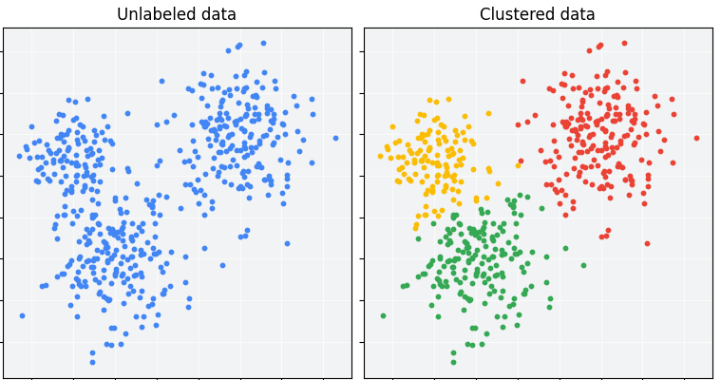
Clustering
Clustering is a technique for finding similar groups in data, called clusters, i.e.,
it groups data instances that are similar to (near) each other in one cluster and data instances that are not similar (far away) to each other into different clusters.
Clustering is often an unsupervised learning task as no class values (labels) indicate group of the data instances.
Clustering is the most common form of unsupervised learning.
clustering is one of the most utilized ML techniques and used in almost every field, e.g., medicine, psychology, sociology, biology, archeology, marketing, insurance, libraries, security, etc.

Slide 3
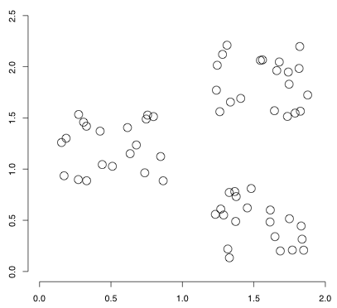
Dataset with clear cluster structures
Features used to recognize similarity of clusters
Feature A
There are 3 cluster structure in this example
Clustering Type
Feature B

Slide 4
Applications of Clustering
• Customer Segmentation
• Data Summarization and Analysis
• Finding representatives (Labels) for unlabeled data groups
• Finding unusual data points and outliers
• Community detection in Network Analysis
Gain insight into the structure of the data
Other application such as Image Processing, object detection, noise identification, etc.

Slide 5
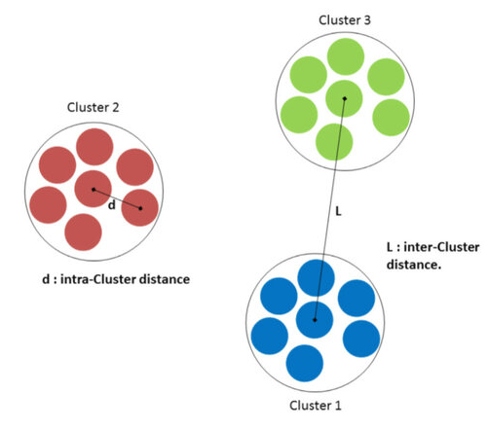
Problem Statement
Given a set of data points, each described by a set of attributes (features), find clusters (groups) such that:
Intra-cluster (within a cluster) similarity is maximized
Inter-cluster (between clusters) similarity is minimized
Requires the definition of a metric for similarity
Notes:
Data

Slide 6
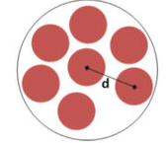
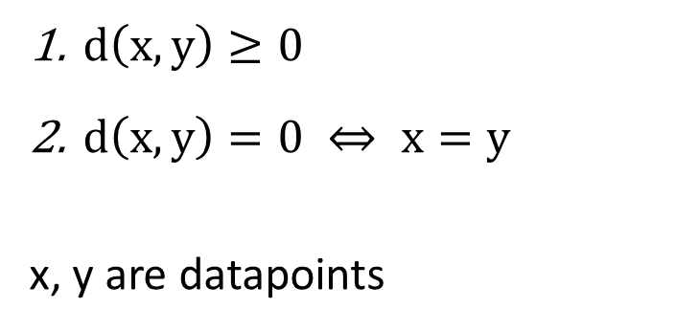
Distance as Loss Function
Similarity indicates less distance between attributes (features) of two data points
A distance measure (metric) is a function that satisfies:
Distance is the Loss Function in clustering
$d\left(x,y\right)≥0$
$d\left(x,y\right)=0 ⇔ x=y$
x, y are datapoints

Slide 7
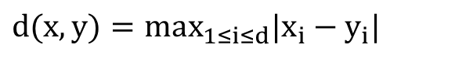
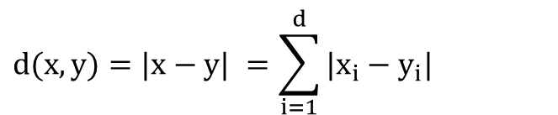
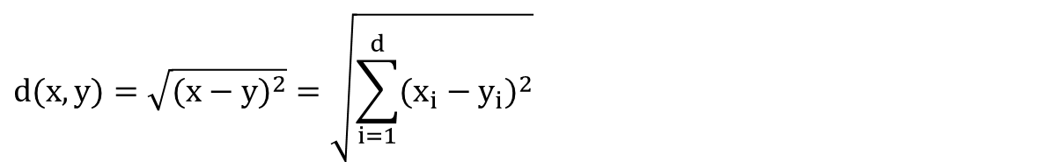
Distance Measures
Euclidean Distance:
Manhattan Distance:
Chebyshev Distance:
$$d(x,y)=\sqrt{(x−y)^{2}}=\sqrt{\sum_{i=1}^{d}{(x_{i}−y_{i})^{2}}}$$
$$d(x,y)=|x−y| =\sum_{i=1}^{d}{|x_{i}−y_{i}|}$$
$$d(x,y)=max_{1≤i≤d}|x_{i}−y_{i}|$$

Slide 8
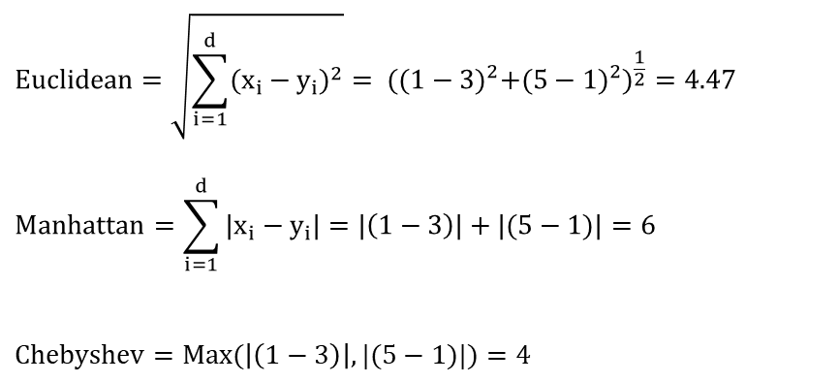
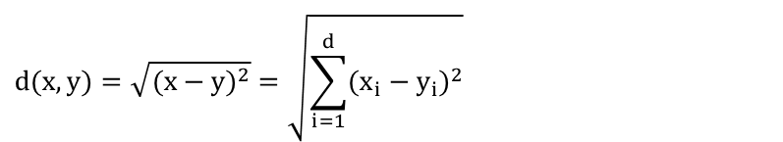
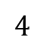
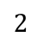
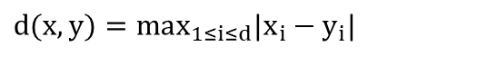
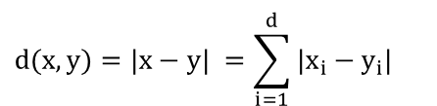
Distance Example
Euclidean Distance:
Manhattan Distance:
Chebyshev Distance:
$$d(x,y)=\sqrt{(x−y)^{2}}=\sqrt{\sum_{i=1}^{d}{(x_{i}−y_{i})^{2}}}$$
$$d(x,y)=|x−y| =\sum_{i=1}^{d}{|x_{i}−y_{i}|}$$
$$d(x,y)=max_{1≤i≤d}|x_{i}−y_{i}|$$
1 2 3 4 5
Feature 2
X (1,5)
$$Euclidean=\sqrt{\sum_{i=1}^{d}{(x_{i}−y_{i})^{2}}}= ({(1−3)}^{2}+{(5−1)}^{2})^{\frac{1}{2}}=4.47$$
$$Manhattan=\sum_{i=1}^{d}{|x_{i}−y_{i}|}=|\left(1−3\right)|+|(5−1)|=6$$
$$Chebyshev=Max(\left|\left(1−3\right)\right|,|(5−1)|)=4$$
$$4$$
Y (3,1)
$$2$$
Feature 1
1 2 3 4

Slide 9
Distance Measures for Categorical Data
Definition of distance depends on the application, type of features and clustering algorithm
There are many other distance metrics (such as Minkowski) which are used in clustering algorithms
There is no universal distance metric that is good for any clustering algorithms and for any problems.

Slide 10
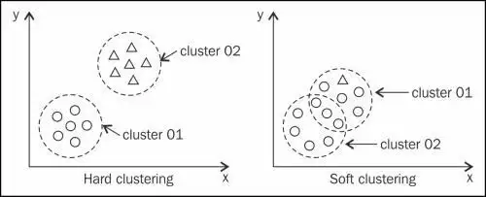
Hard vs. Soft Clustering
Hard clustering: Each datapoint belongs to exactly one cluster
Soft clustering: A datapoint can belong to more than one cluster (e.g., fuzzy clustering)

Slide 11
Main Clustering Approaches
Flat algorithms: The resulting clusters are not in a hierarchical structure
Hierarchical algorithms: The resulting clusters are in a hierarchical structure
Bottom-up (agglomerative)
Top-down (divisive)
Flat
Hierarchical

Slide 12
Partitioning Algorithms (Flat)
The data is divided into several clusters (number of clusters as a Hyper-parameter) in one shot, typically with the use of partitioning representatives, then iteratively improve results.
K-Means: the partitioning representatives (centroid) correspond to the mean of each cluster
K-Medians: the median along each dimension, instead of the mean, is used to create the partitioning representative
K-Medoids: the partitioning representative is sampled from the original data
K-Modes: The mode (most frequent category) is used as the cluster centroid

Slide 13
K-Means Clustering Algorithm
Given k as number of clusters (Hyper-parameter):
Select k random data points as initial centroid (cluster representative)
Repeat
Assign each data point to the nearest centroid
Recompute centroid of each cluster using mean values of attributes
Until convergence criteria is met

Slide 14
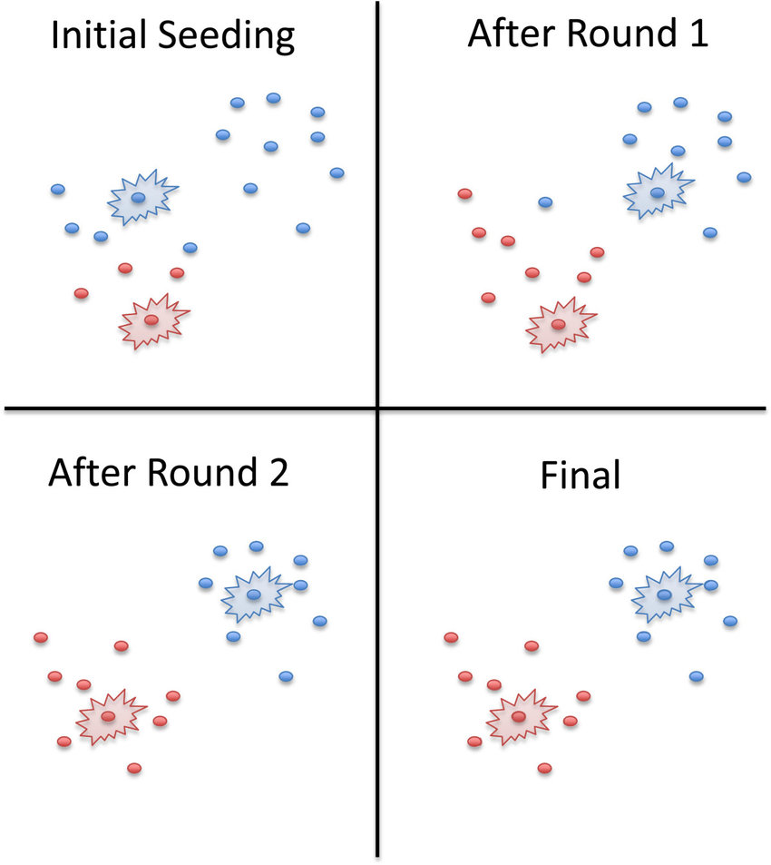
K-means Convergence
K-means is working with a finite number of possibilities, it will eventually reach a point where it repeats itself.
K-means Convergence refers to the process by which the K-means clustering algorithm reaches a stable solution.
K-means convergence typically occurs when:
Centroid Stability: Centroids do not change significantly between iterations.
Cluster Assignment Stability: Data points remain assigned to the same clusters.
Reduction in Objective Function: The total within-cluster sum of squares distances no longer decreases significantly.

Slide 15
K-means Clustering Steps
1- Choose random data points as Centroids
3- Calculates new Centroids
2-Cluster Based on Least Distance
Attributes (Features)
Centroid 2
Centroid 1
4- Repeat Calculation
With Centroids
Unless the change in Centroid is less than 1%

Slide 16
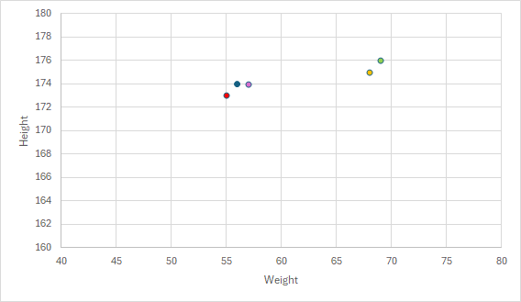
Sample of K-means with two cluster
Features: height(cm) and weight (kg)
No Labels
Weight | Height
68 | 175
69 | 176
57 | 174
55 | 173
56 | 174

Slide 17
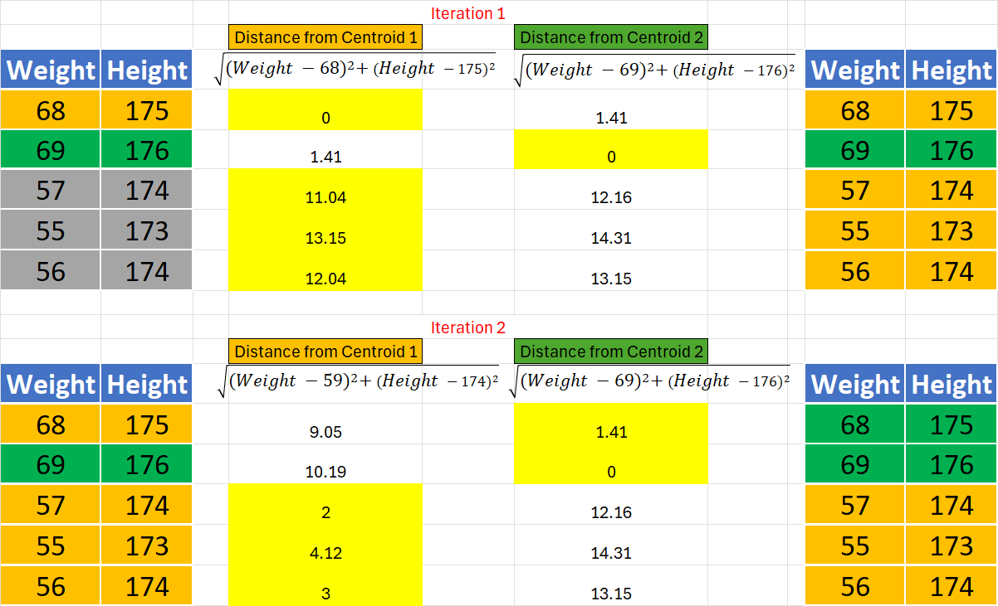
Sample of K-means with two cluster
Centroid 1 =
( (68+57+55+56) /4 , (175+174+173+174) /4 ) = (59,174)
Centroid 2 = (69,176)
Repeat Calculation
With Centroids C1, C2
Unless the change in Centroid is less than 1%
Centroid 1 =
((57+55+56) /3 , (174+173+174) /3 ) = (56,173.6)
Centroid 2 =
((68+69) /2 , (175+176) /2 ) = (68.5,175.5)

Slide 18
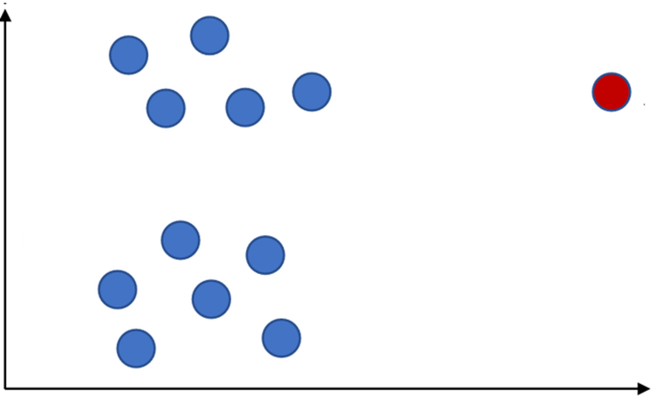
K-means Characteristics
Most common measures which are used in K-means are Manhattan distance (L1 norm) and Euclidean distance (L2 norm).
Applicable only to objects in a continuous n-dimensional space
Sensitive to noisy data and outliers

Slide 19
K-Medians
K-medians defines cluster representatives as the median of the attributes (instead of mean of attributes)
K-medians is more robust to outliers than k-means
C1:
X = 1,1,2,3 Median = 1.5
Y = 1,1,2,2 Median = 1.5
C2:
X = 2,3 Median = 2.5
Y = 3,3 Median = 3

Slide 20
K-Modes
K-modes is appropriate for mixed data types (numeric and categorical)
K-Modes uses the mode (most frequent category) as the cluster centroid.
Instead of Euclidean distance it uses a distance metric for categorical attributes.
Distance (No 1, C1)= 0
Distance (No 2, C1)= 2 Distance (No 3, C1)= 1
Distance (No 4, C1)= 2
Distance (No 5, C1)= 2
Distance (No 6, C1)= 1
C1:
X = 1,1,2,3 Mode = 1
Y = 1,1,2,2 Mode = 1
Distance (No 1, C2)= 2
Distance (No 2, C2)= 0 Distance (No 3, C2)= 2
Distance (No 4, C2)= 1
Distance (No 5, C2)= 1
Distance (No 6, C2)= 2
C2:
X = 2,3 Mode = 2
Y = 3,3 Mode = 3

Slide 21
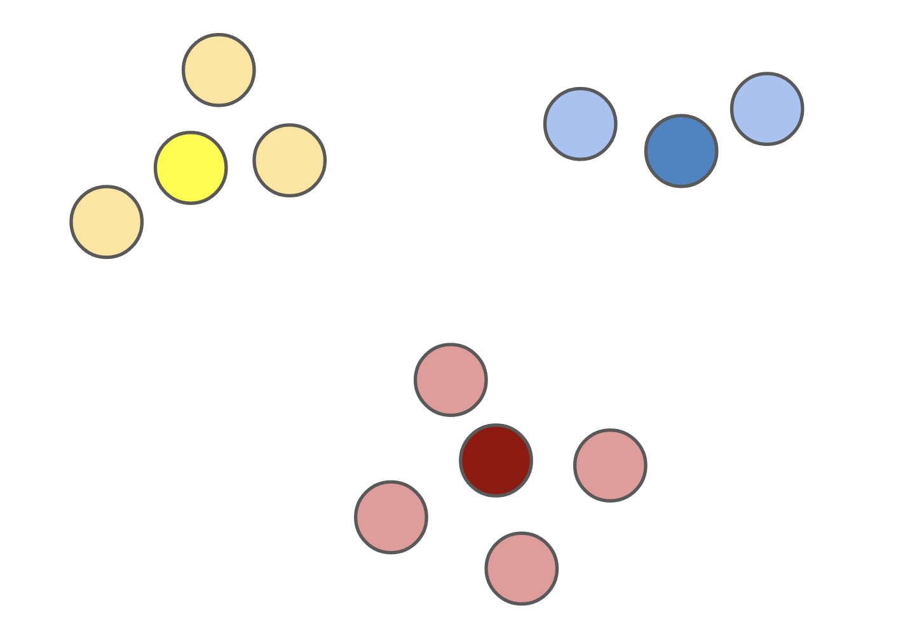
K-Medoids
K-medoids chooses the actual data points as the prototypes
Instead of taking the mean value of the object in a cluster as a reference point, another data point in the cluster can be used as representative, which is the most centrally located object in a cluster (least within-cluster distance)
K-medoids is more resilient to outliers and noises compared to K-means
PAM (Partitioning Around Medoids) is one implementation of K-Medoids

Slide 22
Sample of K-Medoids with two cluster
Choose two random data points (No 4, No 5) as Centroids of Cluster Green (Cluster 1) and Cluster Blue (Cluster 2)
Attributes (Features)
Centroid 2
Centroid 1
Sum of Distances in Cluster 1 =
1.41 + 1 + 0 + 1.41 = 3.82
Sum of Distances in Cluster2 =
1 + 0 = 1
Note: Usually, Manhattan distance is used in K-medoids
But we used Euclidean distance to compare results
Total Distance = 4.82

Slide 23
Swap Centroid 1(No 5) with a random non-medoid data point:
No 1 : (1,1)
Reassign datapoints to two clusters based on distance from new centroids
New-Distance = sum of distances from (1,1) and (3,3)
If New-Distance < 4.82 :
Centroid 1= (1,1)
Best-Distance = New-Distance
Else:
Centroid 1= (2,2) [Keep the last Centroid 1]
Swap Centroid 2(No 4) with a random non-medoid data point:
No 6 : (3,1)
Reassign datapoints to two clusters based on distance from new centroids
New-Distance = sum of distances from (3,1) and Centroid 1
If New-Distance < Best-Distance :
Centroid 2= (3,1)
Best-Distance = New-Distance
Else:
Centroid 2= (3,3) [Keep the last Centroid 2]
Repeat Until Convergence

Slide 24
Weaknesses and Strengths of K-Means Family Algorithms
Strength
Fast (Usually converged after 10 – 20 iterations)
Scalable (Parallel Algorithms of K-Means family e.g. K-means||)
Weakness
Need to specify k, the number of clusters, in advance
Sensitive to initial points
Sometimes terminates at a local optimal

Slide 25
Local Optimal Problem

Slide 26
Improving K-Means Family Algorithms
The major factors that can impact the performance of the K-means algorithm are:
Selection of the initial centroids
Estimating the number of clusters (K)
Most of the variants of the k-means which differ in
Selection of the initial centroids
Dissimilarity calculations
Strategies to calculate cluster representatives (e.g., means , medians, etc.)

Slide 27
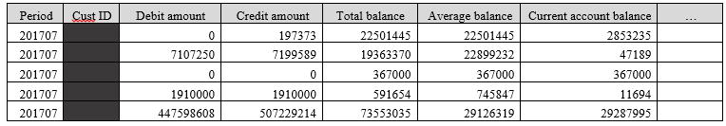
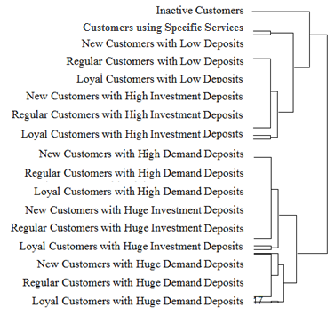
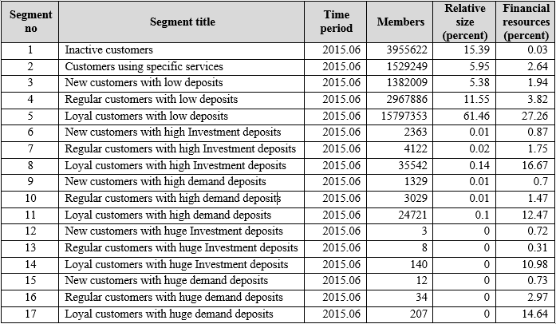
Improve Initialization of Centroids
• Perform several k-means clustering with different random initial centroids and selects the one with the least total distance
• Choose random subsamples from the data and apply K-means
clustering to all these subsamples and find centroids with the least distance
• Using the results of agglomerative hierarchical clustering
Unlabeled data
Hierarchical Clustering
K-Means

Slide 28
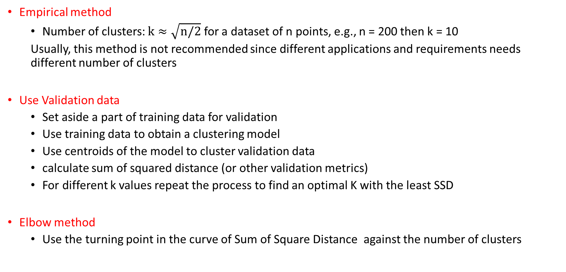
Determine the number of Clusters
Empirical method
Number of clusters: $k≈\sqrt{n/2}$ for a dataset of n points, e.g., n = 200 then k = 10
Usually, this method is not recommended since different applications and requirements needs different number of clusters
Use Validation data
Set aside a part of training data for validation
Use training data to obtain a clustering model
Use centroids of the model to cluster validation data
calculate sum of squared distance (or other validation metrics)
For different k values repeat the process to find an optimal K with the least SSD
Elbow method
Use the turning point in the curve of Sum of Square Distance against the number of clusters

Slide 29
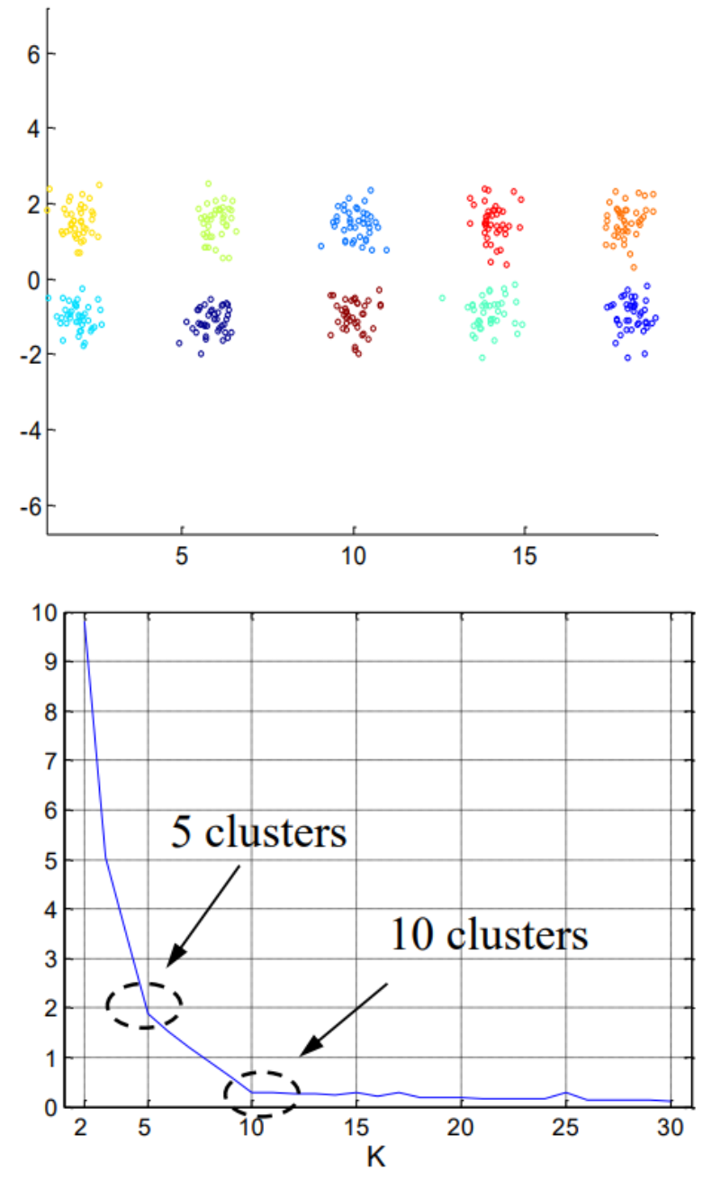
Optimal Number of Clusters
1.00E+03
9.00E+02
8.00E+02
7.00E+02
6.00E+02
Objective Function
5.00E+02
4.00E+02
3.00E+02
2.00E+02
1.00E+02
0.00E+00
k
1
2
3
4
5
6
The abrupt change at k = 2, is highly suggestive of two clusters in the data.
This technique for determining the number of clusters is known as “knee finding” or “elbow finding”.
Resulting clusters of a well-tuned clustering method should be meaningful in the context of business

Slide 30
Problems with Distance-based Algorithms
Distance-base function are not efficient in clustering data structures with different cluster radius
Distance-base function are not efficient in clustering data structures with non-spherical shape

Slide 31
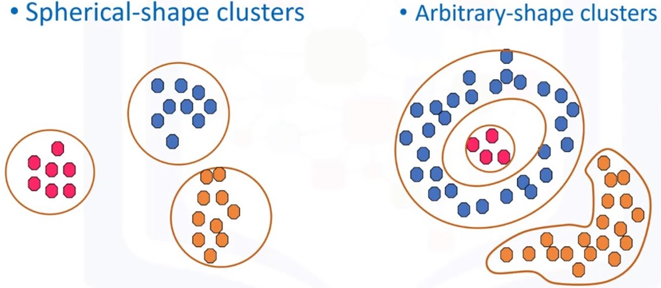
Density-based Methods
Density-based clustering refers to a family of clustering algorithms that work by identifying “dense” clusters of data points, allowing it to learn clusters of arbitrary shape and identify outliers in the data
Density-based algorithms detect areas where data points are concentrated and where they are separated by areas that are empty or sparse

Slide 32
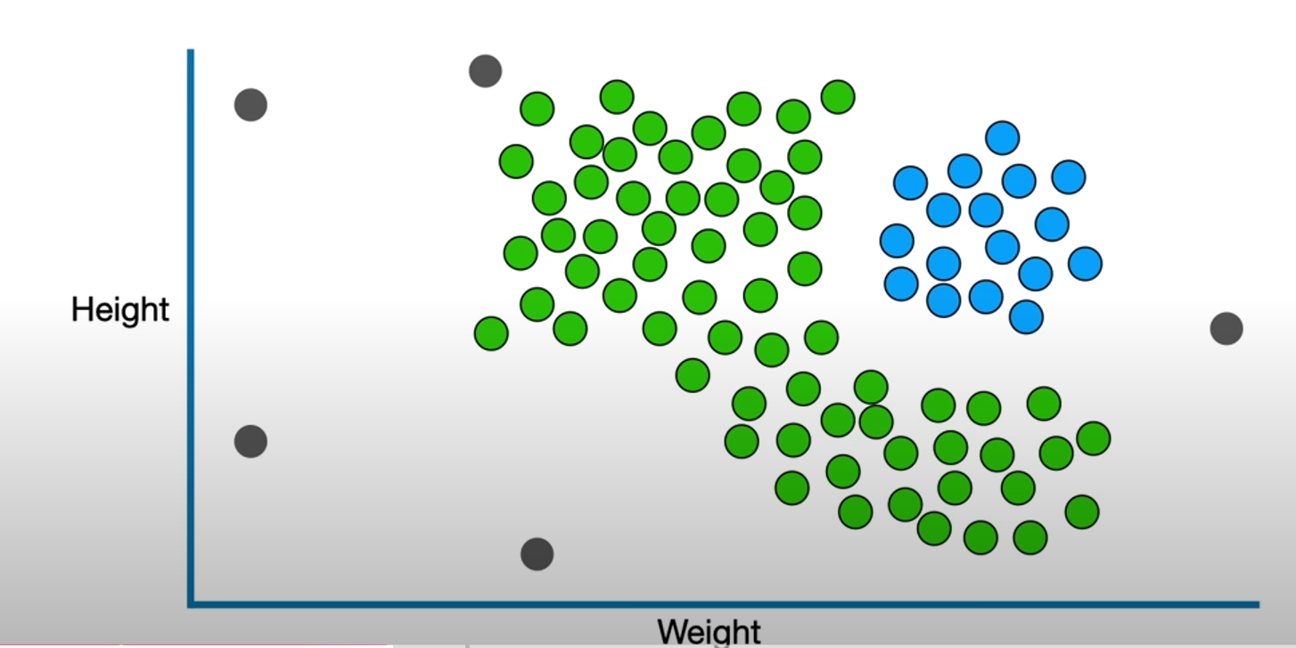
DBSCAN
DBSCAN (Density-Based Spatial Clustering of Applications with Noise) is a popular density-based clustering algorithm that is highly effective for datasets with noise and varying shapes of clusters.

Slide 33
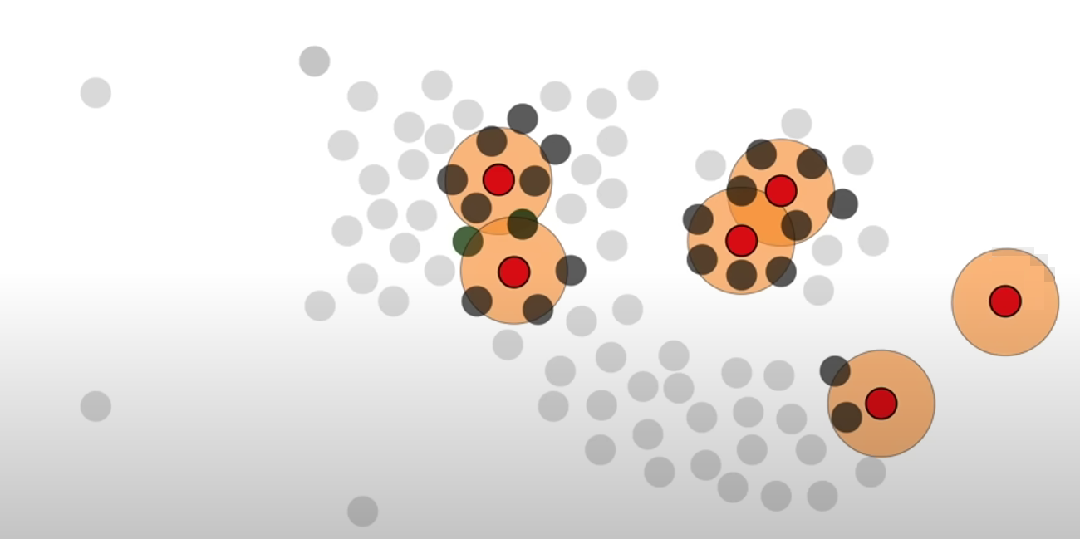
DBSCAN - Step1
For each point, check its neighborhood (within radius hyperparameter).
if the number of points in its neighborhood is greater than or equal to MinPts (hyperparameter), mark it as a core point.
Else mark it as non-core point

Slide 34
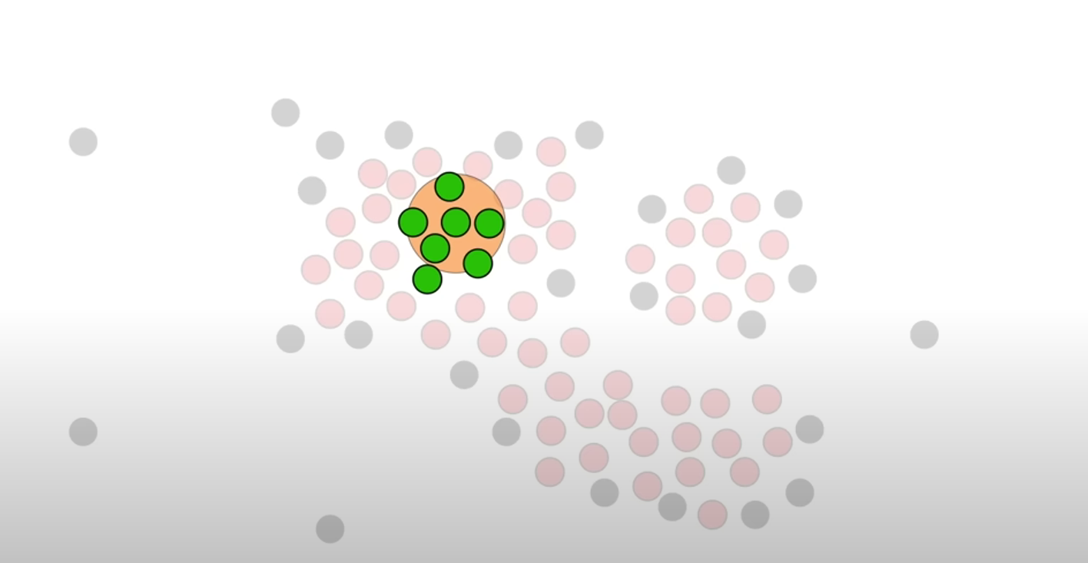
DBSCAN - Step2
Pick a random unvisited corepoint as a member of a new cluster.
All points within the neighborhood of a core point are added to that cluster. This includes other core points and border non-core points.

Slide 35
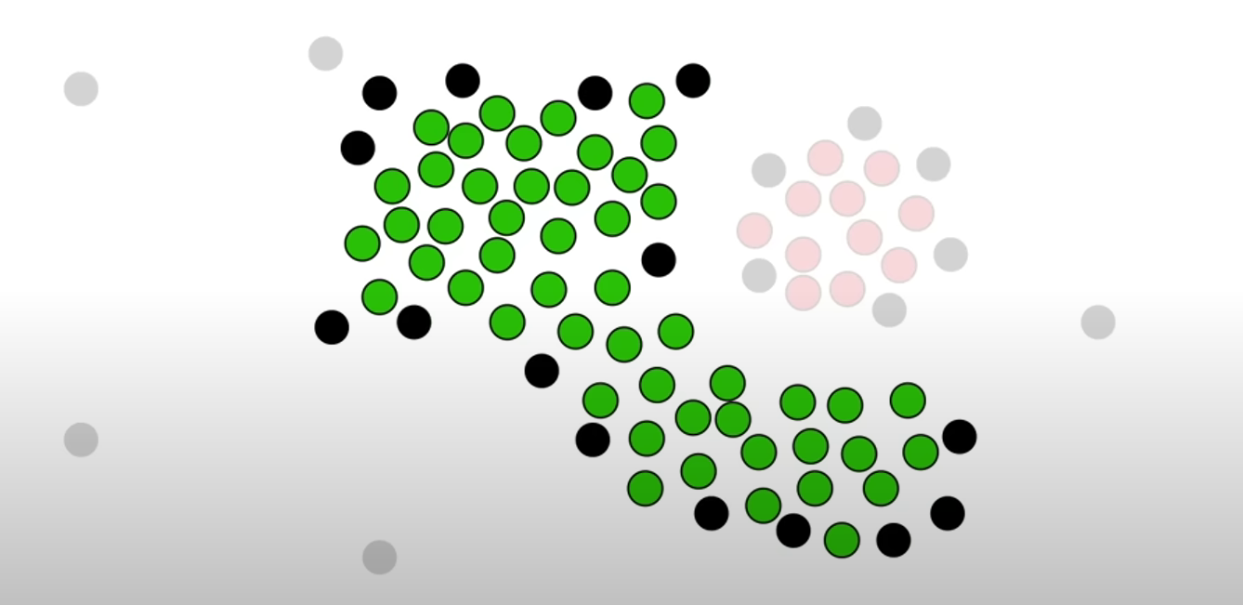
DBSCAN - Step3
For each core point in the cluster, repeat the process, adding its neighborhood to the cluster.
Non-core points can join the cluster but they can't extend the cluster

Slide 36
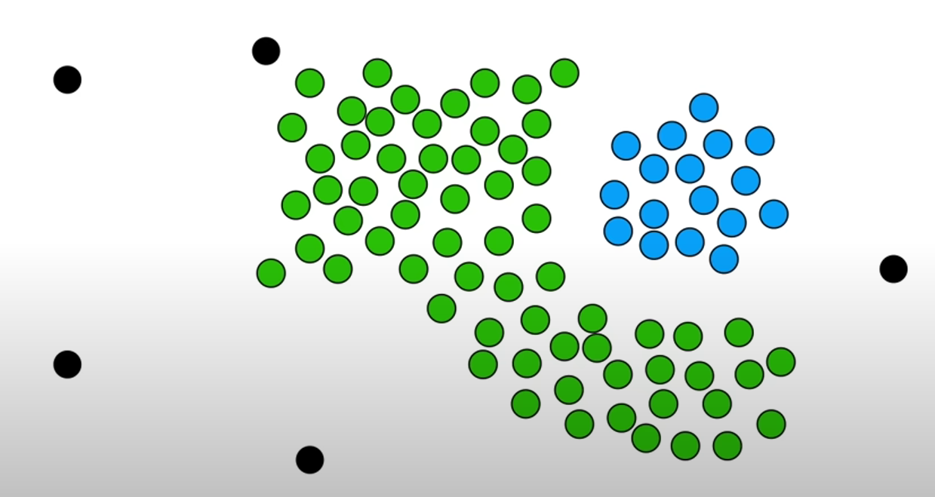
DBSCAN - Step4
Repeat steps 2 and 3 until every core point belongs to a cluster
Every data point out of clusters is considered as outlier

Slide 37
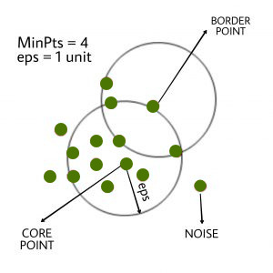
DBSCAN Hyper-parameters
Neighborhood Radius (eps):
A smaller neighborhood value results in smaller clusters and may treat dense points in close proximity as separate clusters.
A larger Neighborhood value results in larger clusters and might group noise into clusters.
MinPts:
Typically, a value of MinPts = 2 * dimensions is chosen. However, the actual value is problem-dependent.
Too small MinPts might lead to detecting too many clusters, including outliers.
Too large a value might miss smaller but significant clusters.

Slide 38
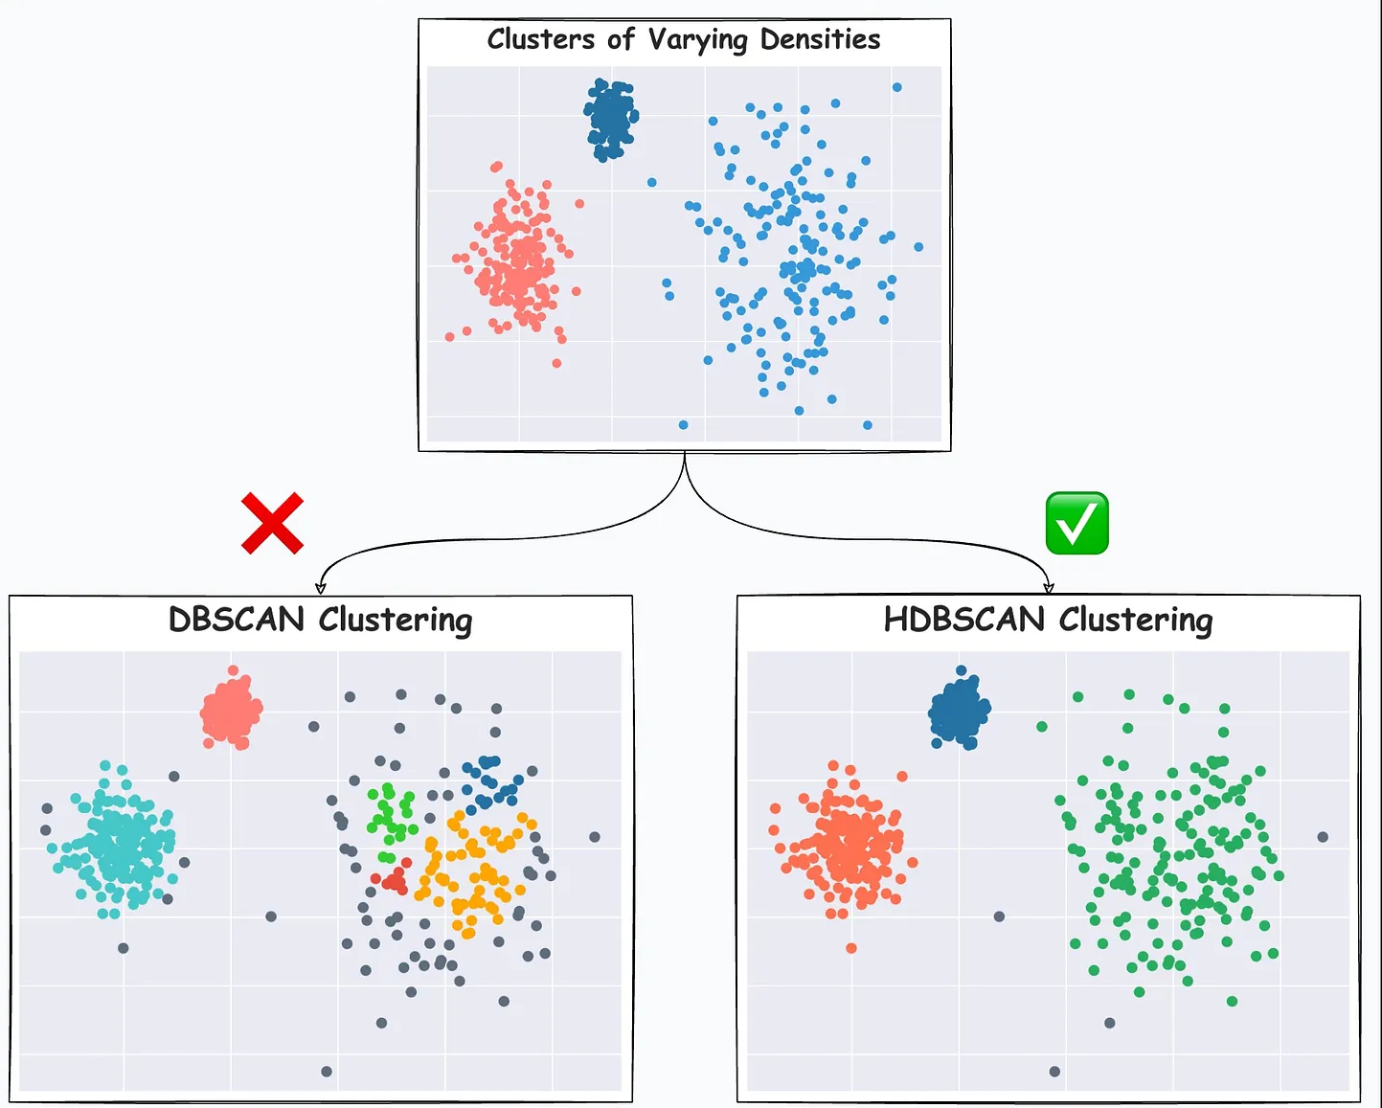
DBSCAN Advantages and Limitation
Advantages:
No need to specify the number of clusters beforehand.
Robust to noise
Clusters of arbitrary shape and non-uniform structures.
Limitation:
Sensitivity to hyperparameters
Difficulty with varying densities since it uses a single density threshold
Prone to the curse of dimensionality

Slide 39
Hierarchical Clustering
Hierarchical clustering is a nested sequence of partitions
Agglomerative (Bottom Up):
Places each object in its own cluster and gradually merge the atomic clusters into larger and larger clusters.
Divisive (Top-down):
Start with all objects in one cluster and subdivide
into smaller clusters.

Slide 40
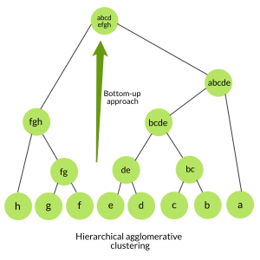
Agglomerative Methods
- Start with a partition P of the data in which each sample is in its own
singleton cluster.
- At each stage, two clusters are chosen from P and merged, forming
a new partition P’.
- The pair which is merged is the one which gives the highest resulting
likelihood (less intra-cluster distance).
- The process is greedy. The best choice at a certain stage (local optimal) does not
necessarily develop into the best global result.

Slide 41
Distance between Clusters
Single linkage (nearest neighbor): In this method the distance between two clusters is determined by the distance of the two closest objects (nearest neighbors) in the different clusters.
Complete linkage (farthest neighbor): In this method, the distances between clusters are determined by the greatest distance between any two objects in the different clusters (farthest neighbors).
Average linkage: In this method, the distance between two clusters is calculated as the average distance between all pairs of objects in the two different clusters.
Other distances e.g., Ward linkage

Slide 42
Agglomerative Example
Euclidean Distance = $\sqrt{(First_AttributeA−Second_AttributeA)^{2}+(First_AttributeB−Second_AttributeB)^{2}}$
Merge 3, 4

Slide 43
Merge 1, 2
Merge 1, 2
Merge 1, 2

Slide 44
Merge 1, 2
Merge 2, 3
Merge 2, 3

Slide 45
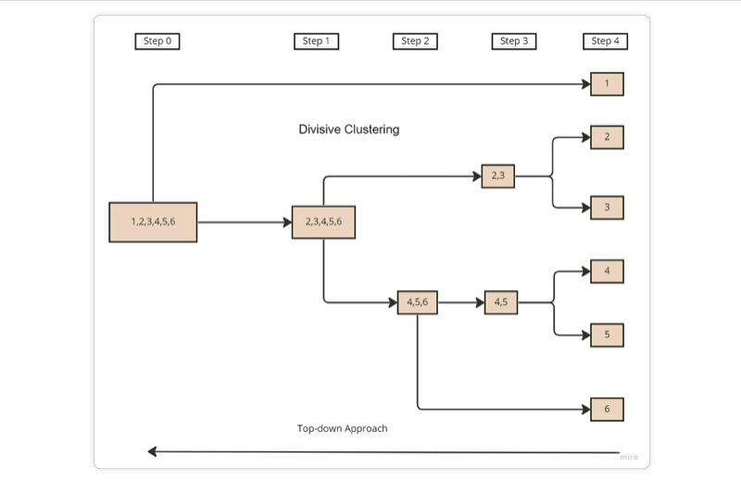
Divisive Hierarchical Clustering
Step 1: Consider all objects in one cluster.
Repeat
Step 2: Spilt the cluster into K (Hyper-parameter) clusters using any flat-clustering method (e.g., k-means).
Step 3: Selects a cluster with the biggest sum of intra-cluster distances based on some distance metric such as Euclidean distance.
Until each data point forms its own cluster.

Slide 46
Divisive vs Agglomerative
Feature | Divisive Hierarchical Clustering | Agglomerative Hierarchical Clustering
Approach | Top-down: Start with one cluster and split | Bottom-up: Start with individual data points and merge
Efficiency | Computationally expensive (especially for large datasets) | Generally, more efficient, but still costly for large datasets
Complexity | Tends to have higher complexity, especially for finding optimal splits | Simpler in terms of iterative merging
Use Case | Preferred for understanding large-scale structure of data | Commonly used in most hierarchical clustering applications

Slide 47
Hierarchal Clustering Advantages & Limitations
No need to specify the number of clusters in advance
Hierarchal nature provides more transparency and interpretability of results for subject matter experts
Gives meaningful insights into structure of data
Like any greedy algorithm, local optimal is a problem
Interpretation of results is subjective
Computationally expensive when dealing with large datasets

Slide 48
Hierarchical Clustering Various Visualizations

Slide 49
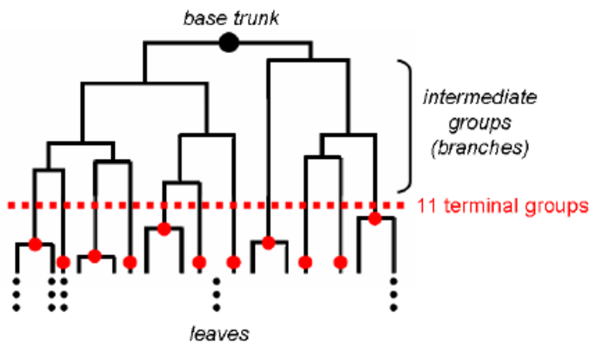
Cut Hierarchical Tree
Elbow Method
Use the turning point in the curve of Sum of Square Distance against the number of clusters
Cluster Validity Approach
Test different levels (cuts) of three with Cluster Validity metrics to find out which one produces the best results

Slide 50
Cluster Validity
Minimize within cluster distance
Maximize between cluster distance
separation
cohesion

Slide 51
Measuring Clustering Quality (Validity)
External: supervised, employ criteria not inherent to the dataset
Compare a clustering against prior or expert-specified knowledge (i.e., the ground truth or labels) using certain clustering quality measure
Internal: unsupervised, criteria derived from data itself
Evaluate the goodness of a clustering by considering how well the clusters are separated, and how compact the clusters are, e.g., Within Cluster Sum of Squared Distance (WCSS) , Silhouette coefficient, Dunn's index
Relative: directly compare different clustering, usually those obtained via different parameter settings for the same algorithm. Often an external or internal index is used for this function, e.g., WCSS

Slide 52
Measuring Clustering Quality: External Methods
Quality is good if it satisfies the following five essential criteria
Cluster homogeneity: the purer, the better
Cluster completeness: how well the data points within a cluster are grouped according to their true class or category
Rag bag: putting a heterogeneous object into a pure cluster should be penalized more than putting it into a rag bag (i.e., “other” category)
Small cluster preservation: Ensuring that small, yet meaningful clusters are not overlooked or merged during the clustering process
Meaningfulness : Clusters should be meaningful in the context of business

Slide 53
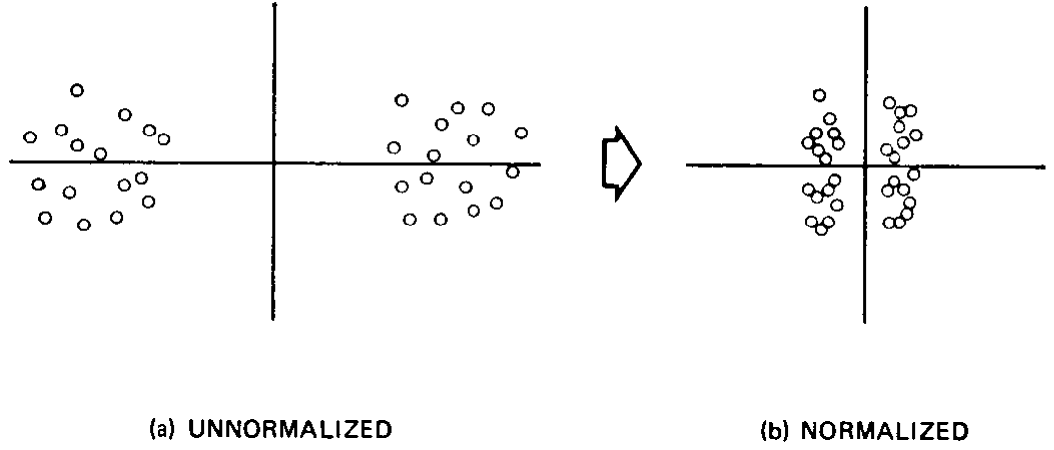
Data Pre-processing for Clustering
Missing Values are required to be imputed before clustering since distance metrics are employed.
Normalizing data is recommended since attributes with larger range of values can bias some distance measures.
Filter out outliers is recommended for many clustering algorithm such as K-means which are prone to outliers

Slide 54
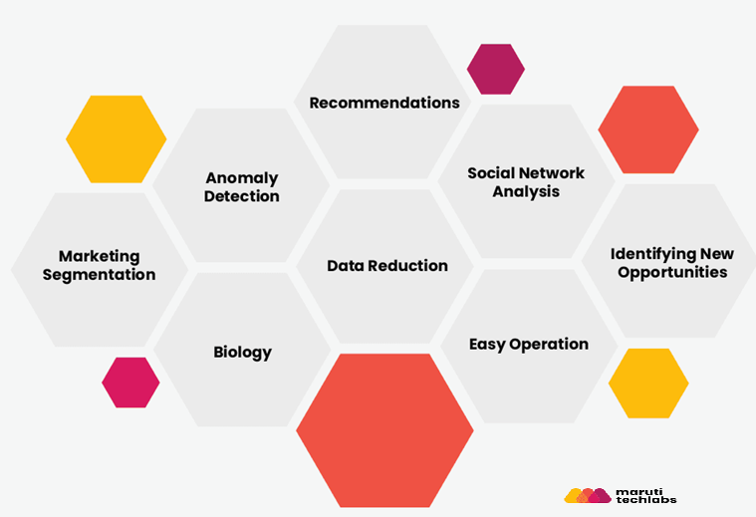
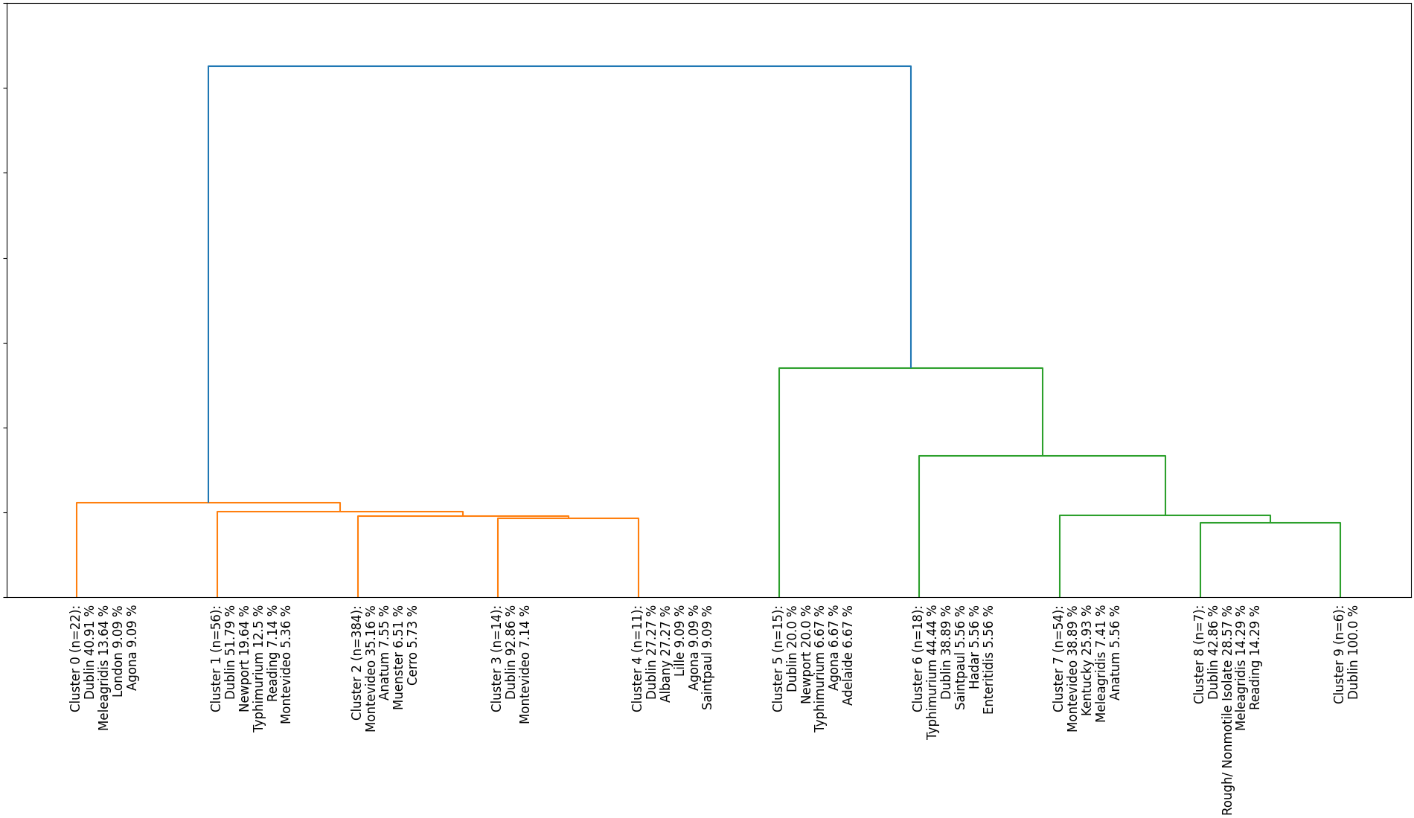
Applications of Clustering

Slide 55
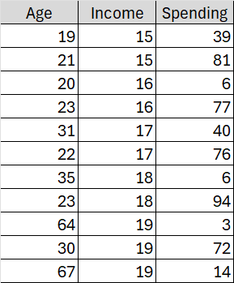
Assignment 3
Find an optimal number of clusters for k-means over the marketing dataset.
Use the optimal cluster number in K-means to cluster the marketing data.
Visualize the relations between income and spending for all resulting clusters using a scatter plot.
Visualize the relations between income and age for all resulting clusters using another scatter plot.
Try to find names for different clusters based on these visualizations.

